Slide 1



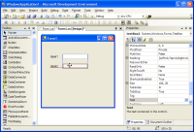
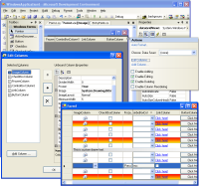
SOA Communication
Front End
FrontEnd.View
WEB Dispatcher :
IP: 10.10.1.200
Prot: HTTP
Serializacion: XML
FrontEnd.BC
REQ
REQ
Wrapper
REQ
Process Service
LAN Dispatcher :
IP: 10.10.1.202
Prot: TCP-IP
Serializacion: Bin
Business Entities
Context Information

Slide 2
Service Orchestration
Service Dispatcher
Metadata
SQL Server
REQ
Operational Data
Service Orchestration
Catching
Transactions
Logs + Adit
BackEnd Components
Cryptography
REQ

Slide 3
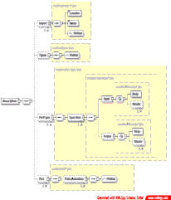
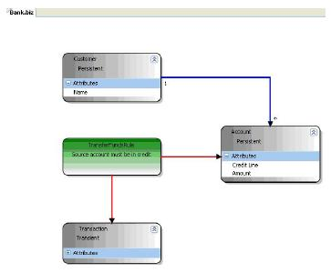
Back-End components
REQ
Components
Oracle
Res = S V C (Req)
SQL Server
I S V C
BE
Connectors
B C
B C
External System
D A C
D A C
D A C
HelperFunctions
IDataContract
IEntity
FWK Components Blocks
IService

Slide 4
Response from service
Front End
FrontEnd.View
WEB Dispatcher :
IP: 10.10.1.200
Prot: HTTP
Serializacion: XML
FrontEnd.BC
RES
RES
Wrapper

